Slide 1

Phone Market App – Capstone Project
Group Members:
Domingo, Arr
Lambert, Kieran
Chahal, Sandeep
Chomyc, Calvin
April 2022
Notes:
[1]
Very good morning people of Canada. Good morning, good afternoon or good evening from the other side. As they say, learning should never stop and learning must be a continuous process. That being said, with over the past 13 weeks of our Full-stack development training program, we definitely learned a lot. From building frontend and backend of an application to interacting with the databases in order to provide necessary information to the application user and to deploying our application using clouds, its no doubt worth our time and effort.
This bootcamp training has come to an end now and we are so grateful to present our capstone project. We are the team who created the "Phone Market App". I am Arr who will talk about Problem Statement as well as the Solution. Next week Ill be joining Infrastructure account of CGI. And I will let the other team members introduce themselves. Give it a shut guys.
(Other member talks……)
So thank you everyone for introducing yourself and making my job easy.[click]

Slide 2
Agenda
01
02
03
04
05
Problem Statement
Solution
Technologies Used
Application Architecture
Application Demonstration
Notes:
[2]
Moving on, these are the agenda of todays presentation. First off is the problem statement that Im going to discuss together with the solution. Technologies Used and Application Architecture to be discussed by Kieran. And finally, the application demonstration/functionalities to be conducted by Calvin and Sandeep.
As a house rule, if you have any questions, please hold til the end of the presentation.
So without any further ado, lets jump into it! [2 minutes]

Slide 3



Problem Statement
Current System Limitations
E-Commerce business looking for a digital solution to market and sell their product.
Tight Competition
Most business that won’t keep pace will eventually lose out on customers and fall behind their competitors
Loss in revenue
Need to keep pace with digital transformation trends to maximize revenue and provide ease of shopping that keeps business competitive.
Notes:
[3]
The company we work-on currently has a website to showcase the phone products available in their store. [click]
However, the current system has several limitations where customer always complain about the product and as part of company’s transformation, they are looking for a digital solution to market and sell their product. [click]
Also, the company is par behind their competitor. Most of their competitors have launched an e-commerce solutions to make it convenient for customers to buy products without the need to visit a store. [click]
All of these factors affects the sales of the company which has resulted in a loss of revenue. The company must comply with current trends of digital transformation to maximize the revenue and to make the business competitive.[click]

Slide 4

Solution
Developed an e-commerce website called Phone Market App
A modern technological platform providing ease of business to customers
Customers can shop and monitor their orders from the comfort of their homes
Great tool making life easier especially in times of a pandemic
Notes:
[4]
So to address the problem of the company and in order to increase the presence of the brand and to reach out to more customers, [click] we developed an e-commerce solution called Phone Market App
This phone market application is a modern technological platform that provides ease of the business. This application is use to automate the process of selling company’s phone products. The customers can basically buy phone products online as well as monitor their orders from the comfort of their homes.
This ecommerce solution is also a great tool for making customer’s life at ease in terms of ordering phone products especially in this times of a pandemic.
Additionally, employees can also manage the products and orders. [click]
So that’s pretty all from my end. Now Ill gonna pass the floor to Kieran to talk about the Technologies used in this capstone project and have a deep-dive about the application architecture.

Slide 5



Behind the Scenes:
Frontend : Angular Framework
Backend: RESTful Web Services
Databases: MongoDB, SQL Server
Unit Test Framework: NUnit
Version Control: Git, GitLab
Languages: C#, Typescript
Other Tools: Consul Service Discovery, Ocelot API Gateway, JWT Token
Notes:
The team used Gitlab as the Version Control System
C# language mainly for backend code that uses ASP.et Web API
Angular framework is use in frontend and the application design uses Material UI and Bootstrap
For the Database, we use MongoDB for unstructured DB and MySQL for the structured DB

Slide 6
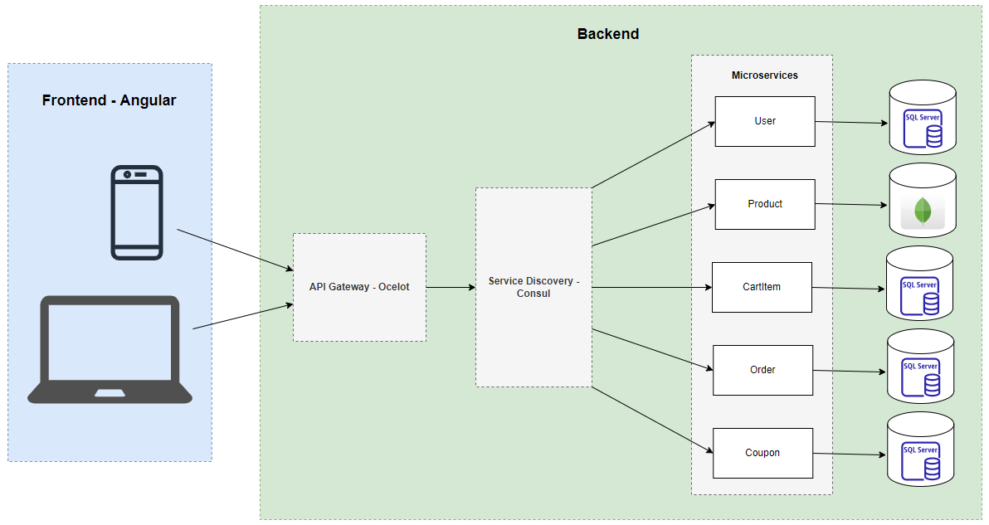
Application Architecture
Notes:
(paste architecture in draw.io)
This is the architecture of our application.
How it works? By using using any device (mobile, laptop, tablet), user can browse the app. It will go to the backend. First touchpoint in the backend is the API Gateway. In our app, we are using ocelot……….

Slide 7

App Demonstration
Let’s have a look at actual stuff !!
This Photo by Unknown Author is licensed under CC BY-NC-ND
Notes:
Homepage
Register
Login using email and password
Product page
Add product [admin]
Update Product [admin]
Delete product [admin]
Place an order [customer]
Add wishlist [customer]
Add discount/coupon [customer]

Slide 8
Lessons Learned
Teamwork
Time Management
Organization
Problem Solving

Slide 9

Questions?
Notes:
Any questions???

Slide 10

Thank You !!
Notes:
END

